Slide 1

Real-Time Ruby for the Real-Time Web aka IM for web-applications
Ilya Grigorik
CTO / PostRank

Slide 2

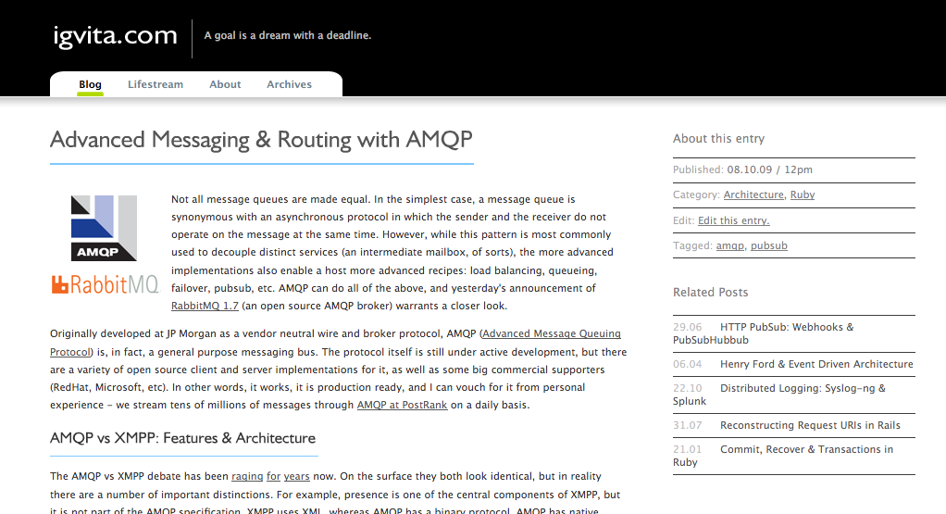
www.postrank.com
www.igvita.com
@igrigorik
Background:
- PHP, Perl
- Ruby + Rails from ‘06

Slide 3
Real-Time: the hype & the technology
Real-Time: the benefits
XMPP
AMQP
PSHB
WebHooks
Ruby examples
Real-life applications
Fully buzzword compliant!
The slides…
Questions & Comments
My blog

Slide 4
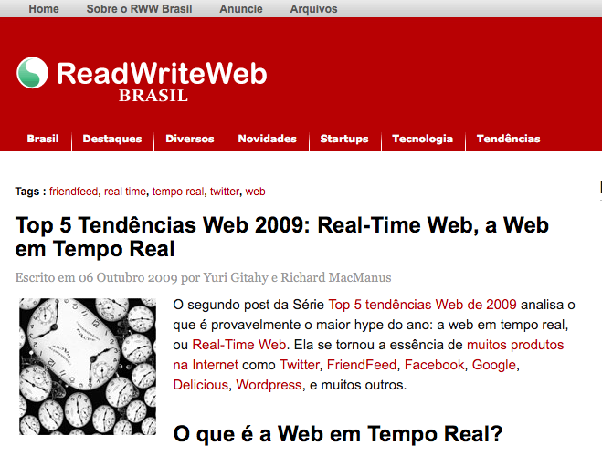
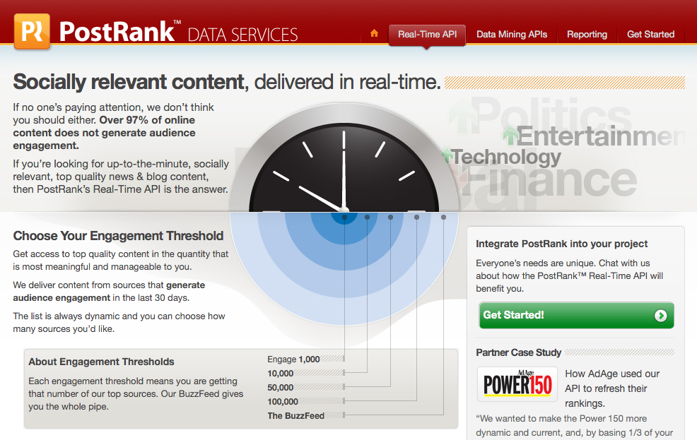

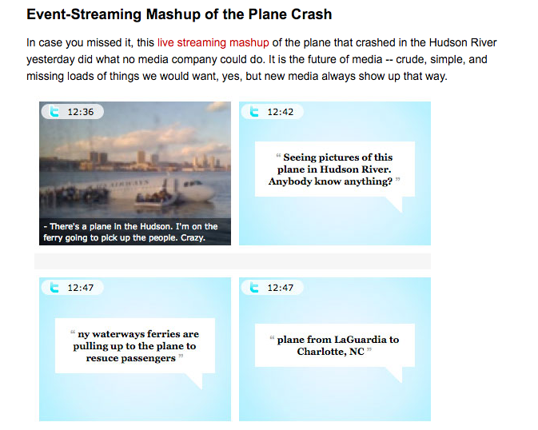
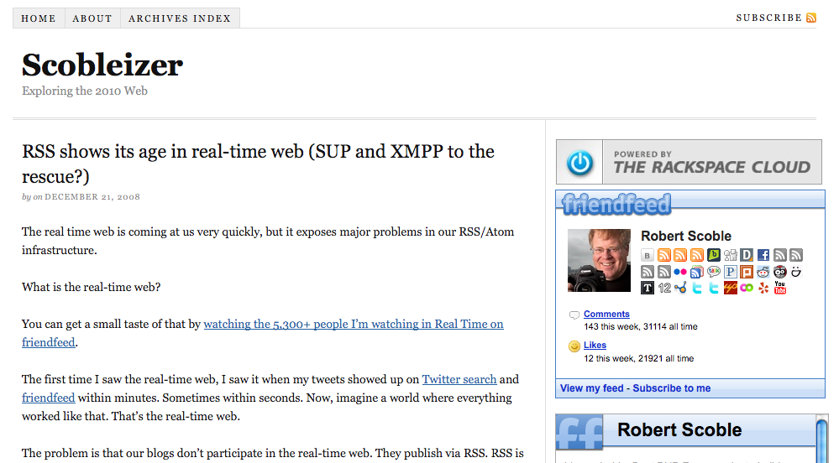
The Hype! Make it stop!
Notes:
- Real-Time: the Marketing gimmicks & buzz
* It's all hype. I'm guilty of it too: PostRank.

Slide 5
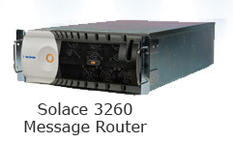





(micro/nano) seconds
“Solution Exhibits Under 700 Nanoseconds of Latency for Inter-Process Communication Messaging”
milliseconds
500ms is real-time enough to feel real-time for IM.
seconds
Real-time web is IM for web-services
minutes / hours
Real-Time has many definitions
It all depends on your context

Slide 6
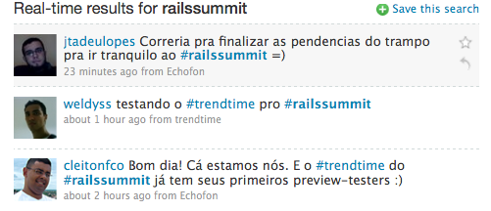
+ New Applications
+ Better Architecture

Slide 7
Many wasteful checks
Data?
No
Data?
No
Data?
Yes
Polling: painful, wasteful

Slide 8



Slide 9
Extensible Messaging and Presence Protocol

Slide 10
From: A, To: B
Hello!
From: A, To: B
Hello!
Extensible Messaging and Presence Protocol (XMPP)

Slide 11
Event-stream protocol
Persistent connections
Presence
XMPP Features
Identity and authentication

Slide 12

User
Domain
Resource
ilya@postrank.com/office
Jabber Software Foundation
JID: Federation, Identity & Authentication
Notes:
Resource
Federation
Client to Server <> Server to Server
Jabber.org is the original IM service based on XMPP, the open standard for instant messaging. The service is run by a small group of volunteers. For that reason, you’ll often find people using Jabber and XMPP as synonyms. For all intents and purposes though, they are exactly the same.
Having said that, each XMPP user has a “JID” or “Jabber ID”, which captures the following components: user, domain and resource.
If you discard the resource component for a second, you’re left with an email address! Hence, as you may guess, the user identification and authentication will be done by a jabber server running on aiderss.com. And then the resource component simply assigns a unique handle, or location for that user. Unlike SMTP, which is stateless, we can have multiple clients be connected to our jabber server, which means we need a unique ID for each one.

Slide 13
<message from="ilya@postrank.com/office" type="chat" to="ilya@igvita.com" id="aae1a">
<body>hello</body>
<active xmlns="http://jabber.org/protocol/chatstates"/>
</message>
Verbose protocol (XML)
Example: Message Routing with XMPP

Slide 14
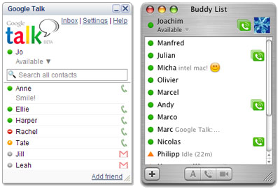
XMPP in the wild: Google Talk

Slide 15
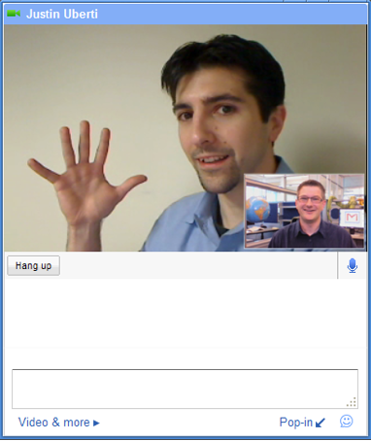
XMPP in the wild: Google Talk + Video
Notes:
XMPP is also not limited to routing text snippets. Recently, Google integrated video chat into their products, once again, using XMPP. You can use XMPP to transfer binary files, real-time video, or anything else that your heart desires (not that it’s a necessarily good idea to do that though).

Slide 16
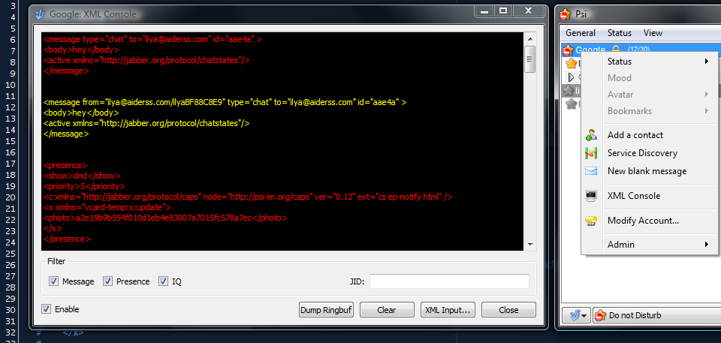
Psi: cross-platform Jabber/XMPP client

Slide 17
require "rubygems"
require "xmpp4r"
jid = Jabber::JID::new("ilya@postrank.com")
client = Jabber::Client.new(jid)
client.connect("talk.google.com")
client.auth("password")
to = "ilya@aiderss.com"
subject = "Jabber client"
message = "Hello XMPP World!"
piclient.send Jabber::Message::new(to, message).set_subject(subject)
# <message to='ilya@igvita.com'>
# <body>Hello XMPP World!</body>
# <subject>Jabber client</subject>
# </message>
XMPP4R (Ruby) Demo

Slide 18
require "rubygems"
require "xmpp4r"
jid = Jabber::JID::new("ilya@postrank.com")
client = Jabber::Client.new(jid)
client.connect("talk.google.com")
client.auth("password")
to = "ilya@postrank.com"
subject = "Jabber client"
message = "Hello XMPP World!"
piclient.send Jabber::Message::new(to, message).set_subject(subject)
# <message to='ilya@igvita.com'>
# <body>Hello XMPP World!</body>
# <subject>Jabber client</subject>
# </message>
XMPP4R (Ruby) Demo

Slide 19
client.send(Jabber::Presence.new.set_type(:away))
# <presence from='daniel@aiderss.com/iMac8D2CB97D' to='ilya@postrank.com/0EDD826C' xmlns='jabber:client'>
# <show>away</show>
# <priority>0</priority>
# <x xmlns='http://www.apple.com/xmpp/idle'>
# <idle-since>2009-04-01T21:48:15Z</idle-since>
# </x>
# </presence>
client.add_message_callback do |m|
puts "#{m.from} -- #{m.body}"
end
# > daniel@postrank.com -- Hey!
Client Idle…
XMPP4R (Ruby) Demo

Slide 20
client.send(Jabber::Presence.new.set_type(:available))
# <presence from='daniel@aiderss.com/iMac8D2CB97D' to='ilya@aiderss.com/0EDD826C' xmlns='jabber:client'>
# <show>away</show>
# <priority>0</priority>
# <x xmlns='http://www.apple.com/xmpp/idle'>
# <idle-since>2009-04-01T21:48:15Z</idle-since>
# </x>
# </presence>
client.add_message_callback do |m|
puts "#{m.from} -- #{m.body}"
end
# > daniel@postrank.com -- Hey!
Client Idle…
XMPP4R (Ruby) Demo

Slide 21
One-to-many distribution + C2S

Slide 22
XEP-0060: Publish-Subscribe (Pubsub)

Slide 23
Persistent connection
Subscribe
New message!
Publish-Subscribe

Slide 24
<iq type='set‘ from='hamlet@denmark.lit/blogbot' to='pubsub.shakespeare.lit' id='pub1'>
<pubsub xmlns='http://jabber.org/protocol/pubsub'>
<publish node='princely_musings'>
<item>
<entry xmlns='http://www.w3.org/2005/Atom'>
<title>Soliloquy<title>
<summary>
To be, or not to be: that is the question!
<summary>
<link rel='alternate' type='text/html'
href='http://denmark.lit/2003/12/13/atom03'/>
<id>tag:denmark.lit,2003:entry-32397</id>
<published>2003-12-13T18:30:02Z</published>
<updated>2003-12-13T18:30:02Z</updated>
</entry>
</item>
</publish>
</pubsub>
</iq>
IQ Stanza
PubSub Protocol: Client XML

Slide 25
<iq type='set‘ from='hamlet@denmark.lit/blogbot' to='pubsub.shakespeare.lit' id='pub1'>
<pubsub xmlns='http://jabber.org/protocol/pubsub'>
<publish node='princely_musings'>
<item>
<entry xmlns='http://www.w3.org/2005/Atom'>
<title>Soliloquy<title>
<summary>
To be, or not to be: that is the question!
<summary>
<link rel='alternate' type='text/html'
href='http://denmark.lit/2003/12/13/atom03'/>
<id>tag:denmark.lit,2003:entry-32397</id>
<published>2003-12-13T18:30:02Z</published>
<updated>2003-12-13T18:30:02Z</updated>
</entry>
</item>
</publish>
</pubsub>
</iq>
AtomPub
PubSub Protocol: Client XML

Slide 26
Distribute
XEP-0060: Publish-Subscribe (Pubsub)
Publish

Slide 27
<message from='pubsub.shakespeare.lit' to='francisco@denmark.lit' id='foo'>
<event xmlns='http://jabber.org/protocol/pubsub#event'>
<items node='princely_musings'>
<item id='ae890ac52d0df67ed7cfdf51b644e901'>
[ ... ENTRY ... ]
</item>
</items>
</event>
</message>
<message from='pubsub.shakespeare.lit' to='bernardo@denmark.lit' id='bar'>
<event xmlns='http://jabber.org/protocol/pubsub#event'>
<items node='princely_musings'>
<item id='ae890ac52d0df67ed7cfdf51b644e901'>
[ ... ENTRY ... ]
</item>
</items>
</event>
</message>
Subscriber A
Subscriber B
XEP-0060: Publish-Subscribe (Pubsub)

Slide 28
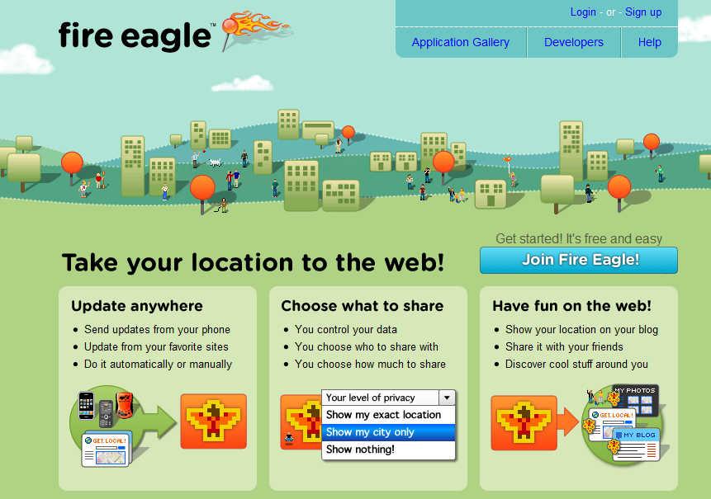
XMPP
XMPP
XMPP
Real-time communication

Slide 29
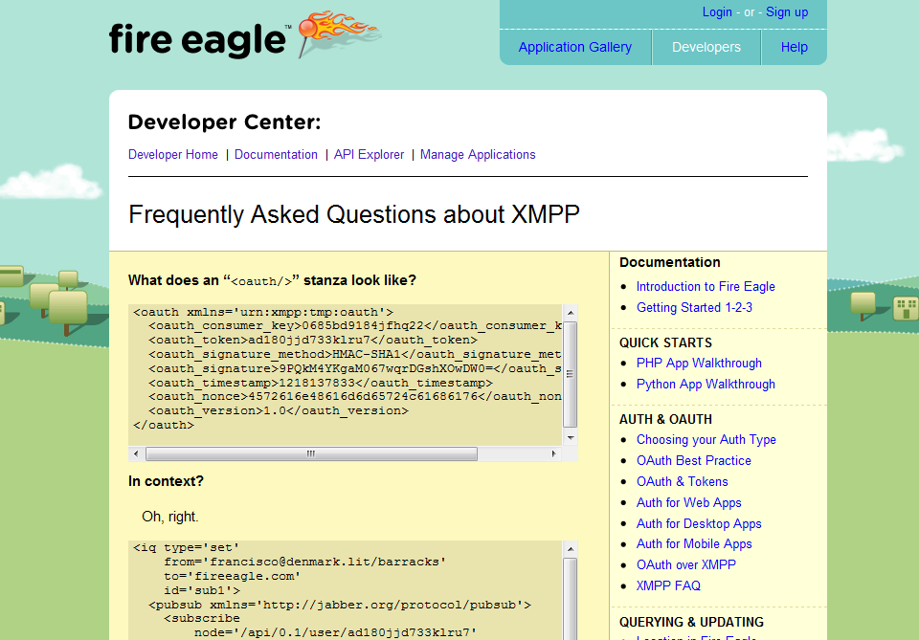
Notes:
Fire eagle exposes an XMPP endpoint which anyone can consume to receive your location updates. This saves them a lot of bandwidth and server resources, since the clients don’t have to poll for updates!

Slide 30
require 'fire_hydrant'
require 'yaml'
hydrant = FireHydrant.new(YAML.load(File.read("config.yml")))
hydrant.on_location_update do |user|
puts "#{user.token} has moved to #{user.locations.first}."
end
hydrant.run!
Push notifications
Ruby + FireEagle via XMPP

Slide 31
Ejabberd Erlang
Djabberd Perl
OpenFire Java
Tigase Java
Defacto XMPP server
RPM, GUI, shiny
XMPP / Jabber Servers
Notes:
Another interesting and fairly popular use for XMPP is the dynamic scalability. Instead of trying to build your own glue to detect and register new servers in the cloud, you could use XMPP and presence to solve this for you: whenever a server comes online, it logs into the XMPP server announcing it’s presence as available. Under load? Set it to “do not disturb”.
If the server falls off the network, the XMPP server will detect that and remove it from its roster.

Slide 32
Advanced Message Queuing Protocol (AMQP)

Slide 33





“AMQP is an open Internet Protocol for Business Messaging”
AMQP Working Group (16 companies)

Slide 34
AMQP Broker
Consumer
AMQP Architecture
Publisher

Slide 35
Broker Clustering
AMQP Clustering

Slide 36
Routing key: usd.stock.amz Message: I like AMZ!
Direct Exchange
Topic Exchange
Fanout Exchange
AMQP Broker Internals

Slide 37
Routing key: usd.stock.amz Message: I like AMZ!
Direct Exchange
Topic Exchange
Fanout Exchange
Queue
Name: amazon Bind: usd.stock.amz
AMQP Direct Exchange

Slide 38
Routing key: usd.stock.amz Message: I like AMZ!
Direct Exchange
Topic Exchange
Fanout Exchange
Queue
Name: stocks Bind: usd.stock.*
AMQP Topic Exchange

Slide 39
Routing key: usd.stock.msft Message: I like Microsoft!
Direct Exchange
Topic Exchange
Fanout Exchange
Queue
Message: I like Microsoft!
AMQP Topic Exchange

Slide 40
Routing key: usd.stock.msft Message: I like Microsoft!
Direct Exchange
Topic Exchange
Fanout Exchange
Queue 1
Queue 2
Name: stocks Bind: “”
AMQP Fanout Exchange

Slide 41
Routing key: usd.stock.msft Message: I like Microsoft!
Direct Exchange
Topic Exchange
Fanout Exchange
Queue 1
Queue 2
Message: I like Microsoft
AMQP Fanout Exchange

Slide 42

AMQP Kung-fu: Load-balancing

Slide 43
Routing key: usd.stock.amz Message: I like AMZ!
Direct Exchange
Topic Exchange
Fanout Exchange
Queue
Only one client gets the message!
AMQP Load Balancing

Slide 44
Bind: purchase.pdf
GET /purchase
OK
Elastic AMQP Load-balancing

Slide 45
More AMQP Kung-fu:
- Pubsub
- Key routing
- Failover
- Instant feedback
- At least once, exactly-once
- …
http://bit.ly/igvita-amqp

Slide 46
require 'mq'
AMQP.start(:host => 'amqp-server.com') do
mq = MQ.new
mq.topic('stocks').publish("5.95", :key => "usd.amz")
end
AMQP.start(:host => 'amqp-server.com') do
mq = MQ.new
mq.queue(’stocks').bind(mq.topic('stocks'), :key => 'usd.*').subscribe{ |price|
print ’stock quote: ', price
}
end
Publisher
AMQP + Ruby Example

Slide 47
require 'mq'
AMQP.start(:host => 'amqp-server.com') do
mq = MQ.new
mq.topic('stocks').publish("5.95", :key => "usd.amz")
end
AMQP.start(:host => 'amqp-server.com') do
mq = MQ.new
mq.queue(‘stocks').bind(mq.topic('stocks'), :key => 'usd.*').subscribe{ |price|
print ‘stock quote: ', price
}
end
Consumer
AMQP + Ruby Example

Slide 48


Slide 49
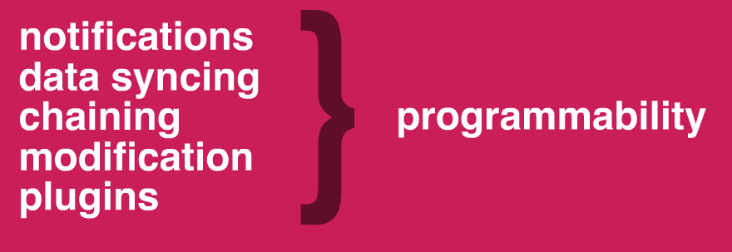
http://blog.webhooks.org/2009/04/23/slides-from-pivotal-labs-talk/
WebHooks:
Pattern for enabling user-defined callbacks in web-applications

Slide 50
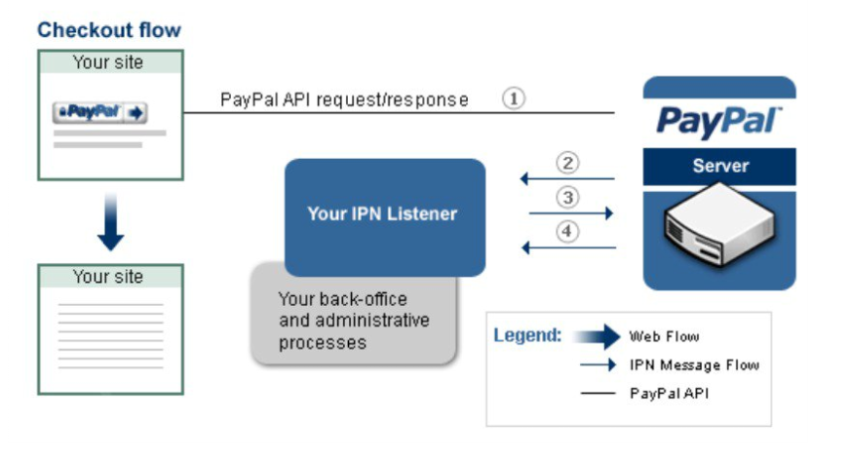
http://blog.webhooks.org/2009/04/23/slides-from-pivotal-labs-talk/
WebHooks @ PayPal

Slide 51
http://blog.webhooks.org/2009/04/23/slides-from-pivotal-labs-talk/
/register http://callback-1.com
/register http://callback-2.com
1
ok
http://blog.webhooks.org/2009/04/23/slides-from-pivotal-labs-talk/
/post Hello World!
2
ok
/post Hello World!
http://callback-1.com
3
WebHooks Workflow
/post Hello World!
http://callback-2.com

Slide 52
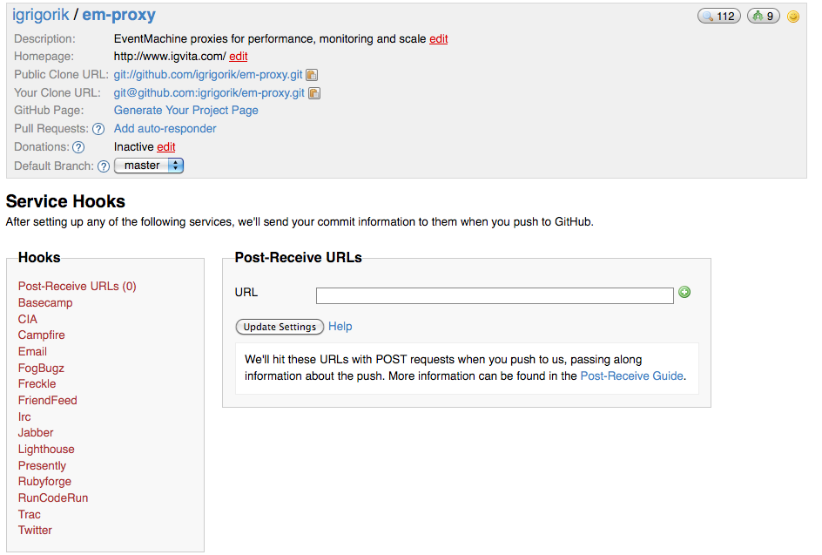
WebHooks Workflow
WebHooks @ GitHub

Slide 53
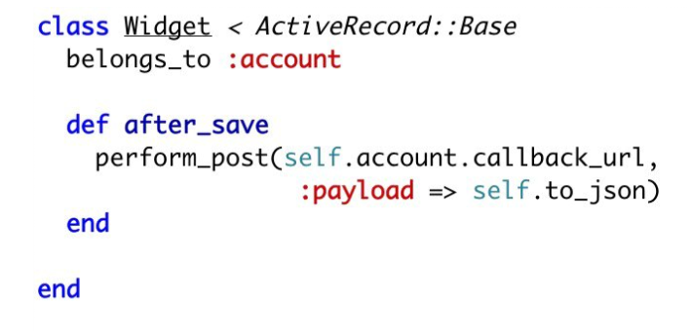
Rails ActiveRecord + WebHooks

Slide 54

http://github.com/jcapote/watercoolr
→ POST /channels
← { 'id':'2d0128d' }
1
2
→ POST /subscribers data={
'channel':'2d0128d',
'url':'http://api.calback.com/handler'
}
← { 'status': 'OK' }
you → POST /messages data={ 'channel':'2d0128d', 'message':'hey guys!' }
watercoolr → POST http://api.callback.com/handler data='hey guys!'
...for every subscriber...
← { 'status': 'OK' }
3
Watercoolr: Ruby WebHooks Server
via a simple Sinatra app

Slide 55

require 'rubygems'
require 'rest_client'
require 'json'
# ruby postbin.rb http://www.postbin.org/1j11vyp
puts "creating channel..."
resp = RestClient.post 'http://watercoolr.appspot.com/channels', :data => ''
id = JSON.parse(resp)["id"]
puts "adding subscriber to channel #{id}"
resp = RestClient.post 'http://watercoolr.appspot.com/subscribers',
:data => { :channel => id, :url => ARGV[0] }.to_json
puts resp # {"status":"OK"}
puts "posting message to #{id}"
resp = RestClient.post 'http://watercoolr.appspot.com/messages',
:data => { :channel => id, :message => 'Hello World' }.to_json
puts resp # {"status":"OK"}
Watercoolr on Google App Engine
DataMapper + Sinatra + Jruby

Slide 56
require 'rubygems'
require 'rest_client'
require 'json'
# ruby postbin.rb http://www.postbin.org/1j11vyp
puts "creating channel..."
resp = RestClient.post 'http://watercoolr.appspot.com/channels', :data => ''
id = JSON.parse(resp)["id"]
puts "adding subscriber to channel #{id}"
resp = RestClient.post 'http://watercoolr.appspot.com/subscribers',
:data => { :channel => id, :url => ARGV[0] }.to_json
puts resp # {"status":"OK"}
puts "posting message to #{id}"
resp = RestClient.post 'http://watercoolr.appspot.com/messages',
:data => { :channel => id, :message => 'Hello World' }.to_json
puts resp # {"status":"OK"}
Watercoolr on Google App Engine
DataMapper + Sinatra + Jruby

Slide 57
require 'rubygems'
require 'rest_client'
require 'json'
# ruby postbin.rb http://www.postbin.org/1j11vyp
puts "creating channel..."
resp = RestClient.post 'http://watercoolr.appspot.com/channels', :data => ''
id = JSON.parse(resp)["id"]
puts "adding subscriber to channel #{id}"
resp = RestClient.post 'http://watercoolr.appspot.com/subscribers',
:data => { :channel => id, :url => ARGV[0] }.to_json
puts resp # {"status":"OK"}
puts "posting message to #{id}"
resp = RestClient.post 'http://watercoolr.appspot.com/messages',
:data => { :channel => id, :message => 'Hello World' }.to_json
puts resp # {"status":"OK"}
Watercoolr on Google App Engine
DataMapper + Sinatra + Jruby

Slide 58
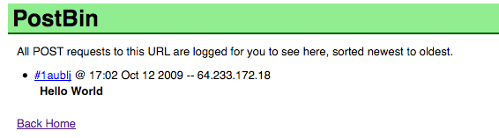
http://bit.ly/igvita-watercoolr
http://www.github.com/igrigorik/watercoolr
http://www.postbin.org
POST’ing to PostBin
great debugging tool

Slide 59
PubSub over HTTP
basically, WebHooks…

Slide 60
“A simple, open, server-to-server web-hook-based pubsub (publish/subscribe) protocol as an extension to Atom and RSS.”
“Parties (servers) speaking the PubSubHubbub protocol can get near-instant notifications (via webhook callbacks) when a topic (feed URL) they're interested in is updated.”
http://pubsubhubbub.googlecode.com/svn/trunk/pubsubhubbub-core-0.2.html
http://docs.google.com/present/view?id=ajd8t6gk4mh2_34dvbpchfs
+ Spec’ed PubSub Protocol
+ Deployed & Available
+ XML Transport
- XML Transport
- Not as general purpose
- No firehose

Slide 61
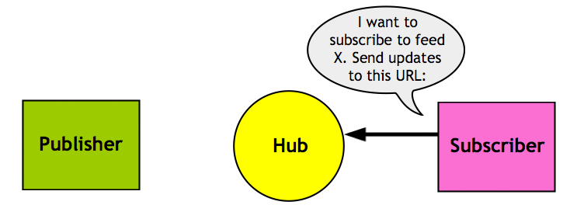
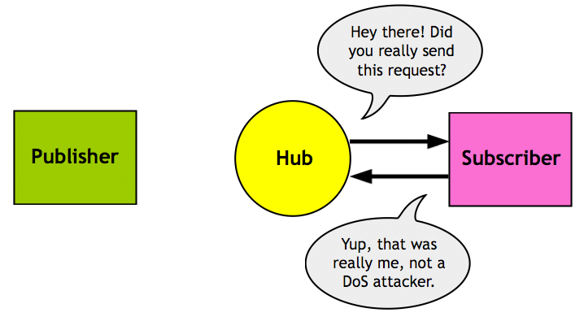
1
2

Slide 62
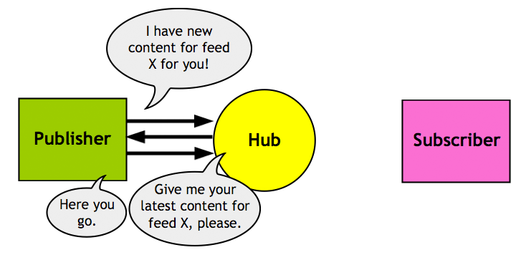
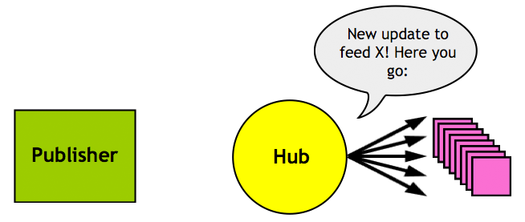
3
4

Slide 63
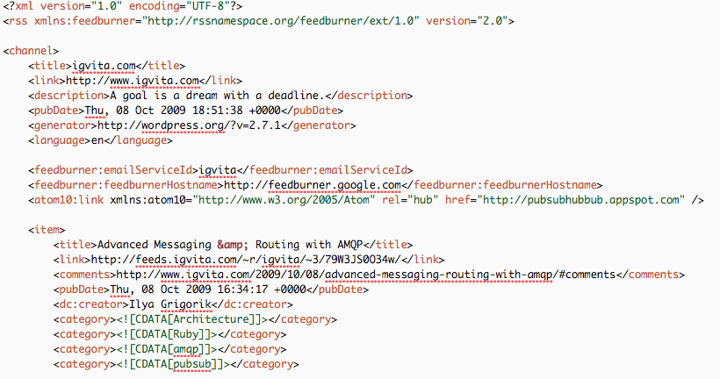
PSHB in the Wild
Google, Typepad, Wordpress…

Slide 64
require 'pubsubhubbub'
EventMachine.run {
hub = EventMachine::PubSubHubbub.new('http://pubsubhubbub.appspot.com/')
# subscribe to real-time notifications
hub.subscribe "http://blog.yoursite.com/atom.xml", "http://yourhub.com/hubbub”
# unsubscribe
hub.unsubscribe "http://blog.yoursite.com/atom.xml", "http://yourhub.com/hubbub”
hub.callback { puts "Processed" }
hub.errback { puts "Error! " + hub.response_header.status.to_s }
}
Consuming PSHB in Ruby
gem install pubsubhubbub

Slide 65
require 'pubsubhubbub'
EventMachine.run {
hub = EventMachine::PubSubHubbub.new('http://pubsubhubbub.appspot.com/')
# subscribe to real-time notifications
hub.subscribe "http://blog.yoursite.com/atom.xml", "http://yourhub.com/hubbub”
# unsubscribe
hub.unsubscribe "http://blog.yoursite.com/atom.xml", "http://yourhub.com/hubbub”
hub.callback { puts "Processed" }
hub.errback { puts "Error! " + hub.response_header.status.to_s }
}
Consuming PSHB in Ruby
gem install pubsubhubbub

Slide 66
require 'pubsubhubbub'
EventMachine.run {
hub = EventMachine::PubSubHubbub.new('http://pubsubhubbub.appspot.com/')
# subscribe to real-time notifications
hub.subscribe "http://blog.yoursite.com/atom.xml", "http://yourhub.com/hubbub”
# unsubscribe
hub.unsubscribe "http://blog.yoursite.com/atom.xml", "http://yourhub.com/hubbub”
hub.callback { puts "Processed" }
hub.errback { puts "Error! " + hub.response_header.status.to_s }
}
Consuming PSHB in Ruby
gem install pubsubhubbub

Slide 67
require 'pubsubhubbub'
EventMachine.run {
hub = EventMachine::PubSubHubbub.new('http://pubsubhubbub.appspot.com/publish')
# publish notification to all subscribers
hub.publish ['http://www.test.com', 'http://www.test.com/2']
hub.callback { puts "Notified PSHB Hub" }
hub.errback { puts "Notification failed" + hub.response_header.status.to_s }
}
Publishing PSHB in Ruby
gem install pubsubhubbub

Slide 68
require 'pubsubhubbub'
EventMachine.run {
hub = EventMachine::PubSubHubbub.new('http://pubsubhubbub.appspot.com/publish')
# publish notification to all subscribers
hub.publish ['http://www.test.com', 'http://www.test.com/2']
hub.callback { puts "Notified PSHB Hub" }
hub.errback { puts "Notification failed" + hub.response_header.status.to_s }
}
Publishing PSHB in Ruby
gem install pubsubhubbub

Slide 69
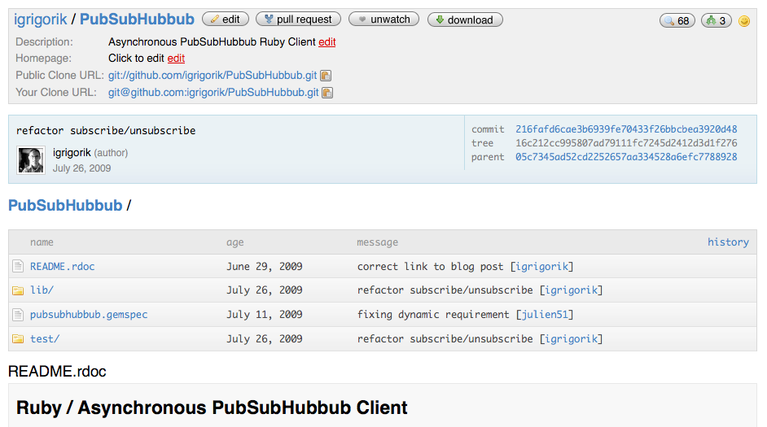
http://github.com/igrigorik/pubsubhubbub

Slide 70
Real-Time Web = “IM for web applications”
XMPP : Presence
AMQP : Routing
WebHooks : Extensibility
PubsubHubbub : PubSub over HTTP

Slide 71

Related Blog Posts:
http://bit.ly/igvita-amqp
http://bit.ly/igvita-webhooks
http://bit.ly/igvita-pshb
Questions?
The slides…
Questions & Comments
My blog

